Slide 1
Drifter Follower
Pat Welch
August-2020

Slide 2
Data Flow
Waypoint SQLite3
DB
Drifter
Glider
Goto
Generator
gliderfs2
Iridium via Satellite
Pattern
YAML
Iridium via Satellite
Iridium
SBD
Iridium
Modem
DirectIP via Internet
DirectIP via Internet
Trigger
Trigger
SFMC API OSU Network
GSatMicro
Listener
gliderfs2
SFMC gliderfmc0
Drifter Path
Estimation
gliderfs2
Glider SQLite3
DB
Dialog
Consumer
gliderfs2
Drifter SQLite3
DB
SFMC API OSU Network

Slide 3
Logic Flow
Drifter GPS fixes are every 15 minutes and stored in a database
When the glider calls in SFMC sends the dialog to the Dialog Consumer.
When SBD and TBD files are being sent from the glider to SFMC, a new goto file is generated and sent to SFMC.
After the SBD and TBD files are done being sent from the glider to SFMC, the new goto file is sent to the glider.

Slide 4
Sample Goto
behavior_name=goto_list # Drifter follower # Generated: 2020-08-04 00:58:39+00:00 # DRIFTER pos: 44.746569, -124.699091 # vel: 0.0048, 0.0253 m/sec # speed: 0.0257 m/sec # theta: 10.8 degrees true # GLIDER pos: 44.745388, -124.681929 # speed: 0.2752 m/sec # WATER vel: 0.1631, -0.0709 m/sec # speed: 0.1779 m/sec # theta: 113.5 degrees true # PATTERNS: # i=0 PATTERN: [707,0] False # i=1 PATTERN: [-707,0] False # i=2 PATTERN: [0,707] False # i=3 PATTERN: [0,-707] False # index=0 <start:b_arg> b_arg: num_legs_to_run(nodim) -1 b_arg: start_when(enum) 0 # BAW_IMMEDIATELY b_arg: list_stop_when(enum) 7 # BAW_WHEN_WPT_DIST b_arg: initial_wpt(enum) 0 b_arg: num_waypoints(enum) 6 <end:b_arg> <start:waypoints> -12441.38386131709 4444.891010636509 # i=0, dist=692m, dt=1:58:16, 2020-08-04 02:56:55+00:00 -12442.40329811835 4445.084871441223 # i=1, dist=1393m, dt=3:56:39, 2020-08-04 06:53:34+00:00 -12441.853138407723 4445.520744841862 # i=2, dist=1086m, dt=1:06:06, 2020-08-04 07:59:40+00:00 -12441.837061421007 4444.817360891085 # i=3, dist=1303m, dt=1:13:19, 2020-08-04 09:13:00+00:00 -12441.28685376142 4445.253234375147 # i=0, dist=1086m, dt=1:06:06, 2020-08-04 10:19:06+00:00 -12442.306402952647 4445.447096164155 # i=1, dist=1393m, dt=3:56:39, 2020-08-04 14:15:45+00:00 <end:waypoints>

Slide 5
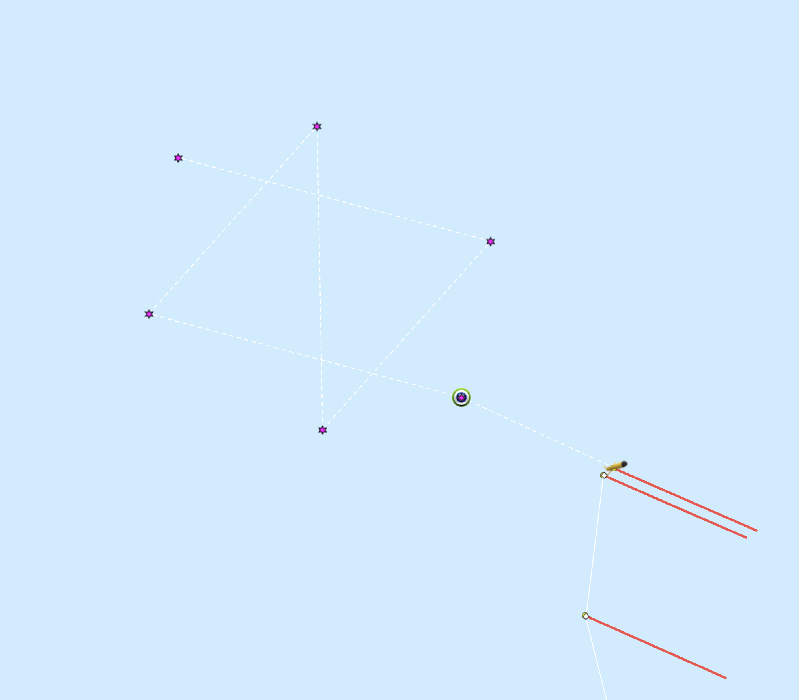
SFMC Dashboard a butterfly pattern, E->W->N->S->E Drifter moving NNE orange line

Slide 6
Software is available at
https://github.com/mousebrains/GSatMicroListener

Slide 7
patterns.yaml
#
# Patterns for flying a glider around a moving drifter
#
osu683: # Glider to work with
IMEI: "300234068117290" # Which beacon to follow
qRotate: False # Rotate the pattern so the x/eastward is along drifter velocity
norm: 707 # km to meters, 1000/root(2) so 1km on a side
theta: 0 # rotate pattern by this many degrees northwards
pattern: # pattern in km with drifter at the center
- [ 1, 0] # East, North
- [-1, 0] # East, North
- [ 0, 1] # East, North
- [ 0,-1] # East, North

Slide 8
One specifies the glider one wants to apply the pattern to, in this case osu683.
IMEI is the GPS beacon the glider will follow.
qRotate specifies if the pattern is rotated such that the x axis of the pattern is aligned with lines of latitude or along the drifter's velocity vector.
norm is an overall scaling factor.
theta allows a rotation of the pattern. (This is what you were asking about.)
pattern is a list of x,y coordinates of the pattern.
With qRotate False, +x will be eastwards and +y will be northwards.
The actual pattern used is scaled by norm and rotated by theta.
Then possibly rotated again if qRotate is True.
The actual pattern should end up in meters.
The number of points in the pattern is only limited by your imagination, but less than ~50 is a reasonable number.
The algorithm to find the closest point to start with is linear in N.
Currently the patterns.yaml file lives on gliderfmc0 in the /home/pat/GSatMicroListener directory. If the file is modified, then the software will automatically reload the file. Currently only Anatoli or I have access to gliderfmc0.
Initially, after the pattern is loaded or reloaded, the first point the glider flies to will be the closest in time. After that, it flies through the pattern list sequentially.
If the pattern has not been reloaded, then the new goto will start with the pattern point that corresponds to the current waypoint in the previous generated goto file.

